Slide 1
Project 3 | Approach & Hints
Refer to Chapter 10 & 12 materials
Text includes bits and pieces of code
Implement project as if it’s a (singly) linked list first
Modify project to become doubly linked list

Slide 2
Chapter 10 & 12 | Topics

Slide 3
Linked Implementation
Advantages
Avoids moving data when adding or removing entries
Uses memory only as needed
When entry removed, memory returned to system

Slide 4
Data Fields and Constructor (Part 1)
/** A linked implemention of the ADT list. */
public class LList<T> implements ListInterface<T>
{
private Node firstNode; // Reference to first node of chain
private int numberOfEntries;
public LList()
{
initializeDataFields();
} // end default constructor
public void clear()
{
initializeDataFields();
} // end clear
/* < Implementations of the public methods add, remove, replace, getEntry, contains,
getLength, isEmpty, and toArray go here. >
. . . */
// Initializes the class's data fields to indicate an empty list.
private void initializeDataFields()
{
firstNode = null;
numberOfEntries = 0;
} // end initializeDataFields

Slide 5
Data Fields and Constructor (Part 2)
// Returns a reference to the node at a given position.
// Precondition: The chain is not empty;
// 1 <= givenPosition <= numberOfEntries.
private Node getNodeAt(int givenPosition)
{
// Assertion: (firstNode != null) &&
// (1 <= givenPosition) && (givenPosition <= numberOfEntries)
Node currentNode = firstNode;
// Traverse the chain to locate the desired node
// (skipped if givenPosition is 1)
for (int counter = 1; counter < givenPosition; counter++)
currentNode = currentNode.getNextNode();
// Assertion: currentNode != null
return currentNode;
} // end getNodeAt
private class Node
{
// < Implementation of private inner class Node >
} // end Node
} // end LList
An outline of the class LList

Slide 6
Adding a Node
Possible cases:
Chain is empty
Adding node at chain’s beginning
Adding node between adjacent nodes
Adding node to chain’s end

Slide 7
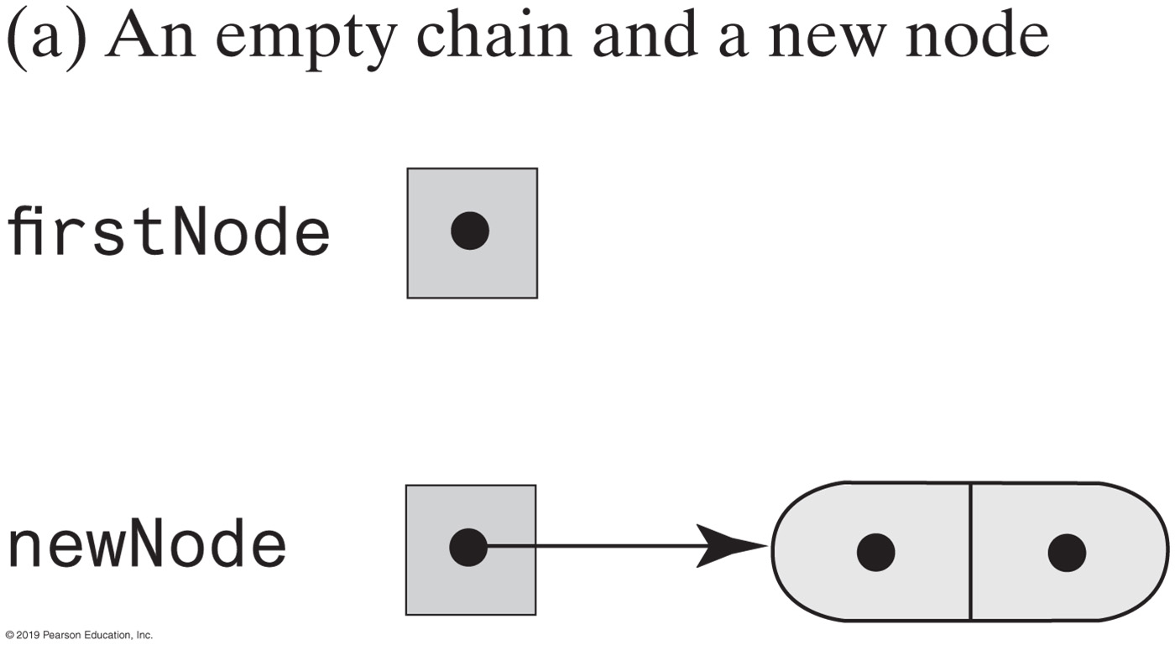
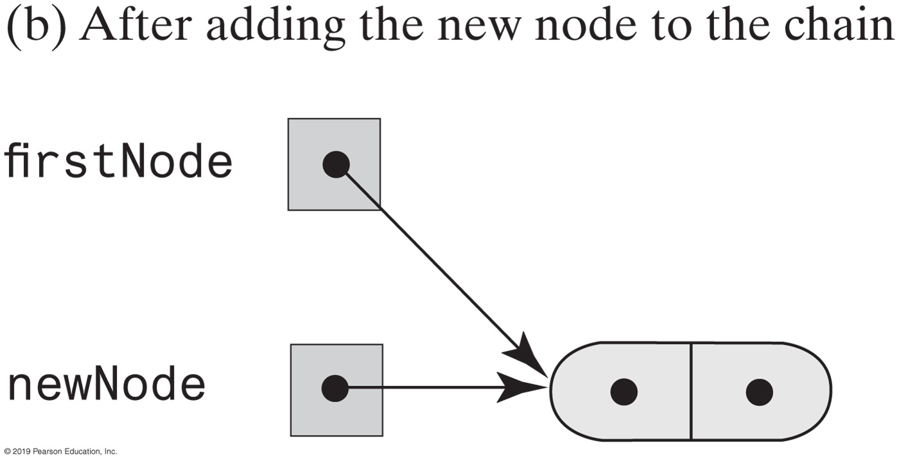
Adding a Node | Empty Chain

Slide 8
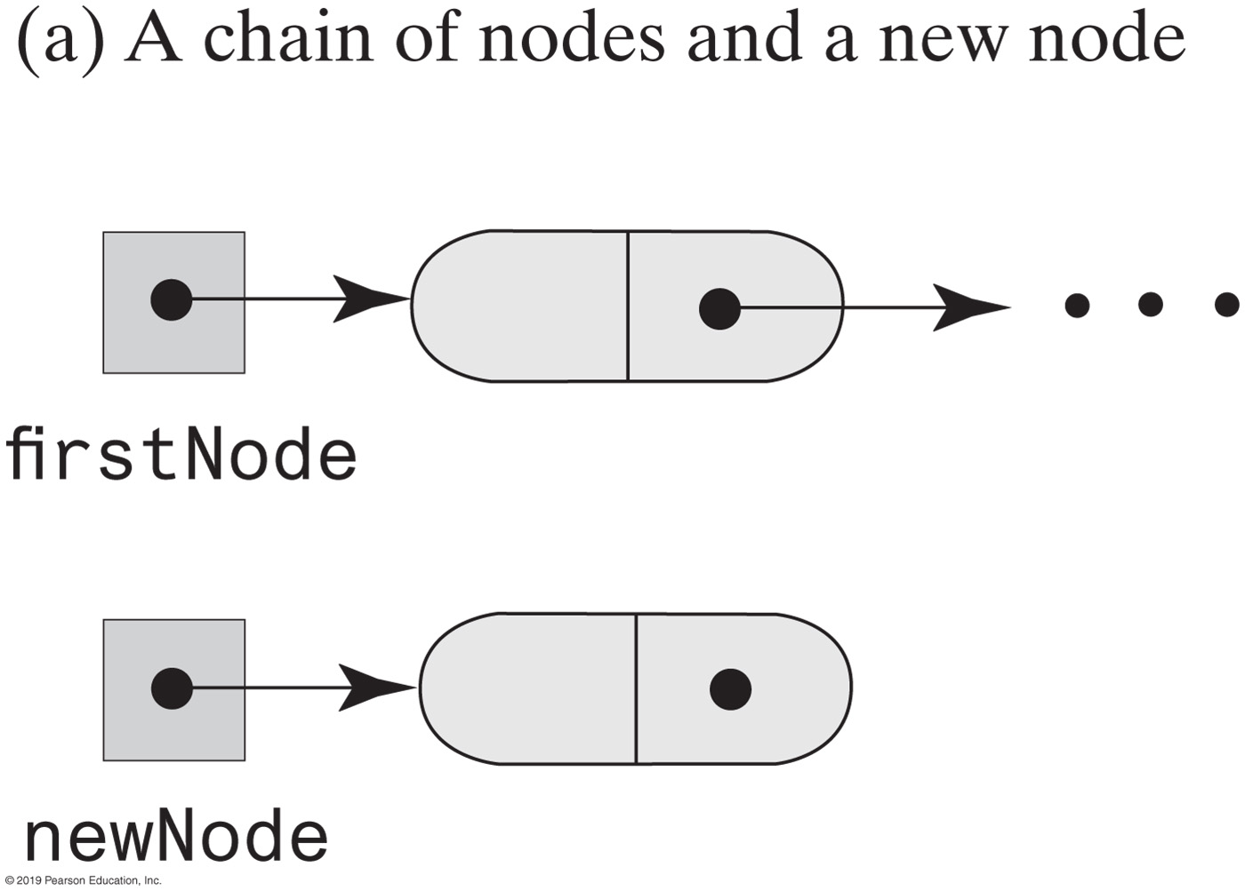
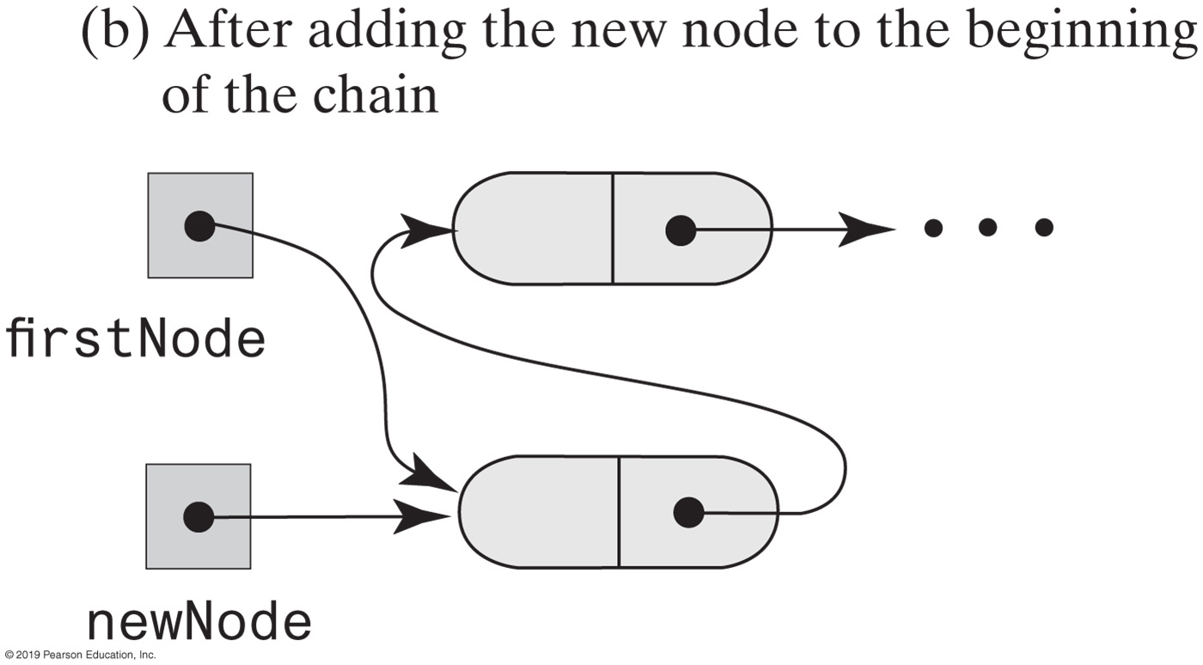
Adding a Node | Beginning of Chain

Slide 9
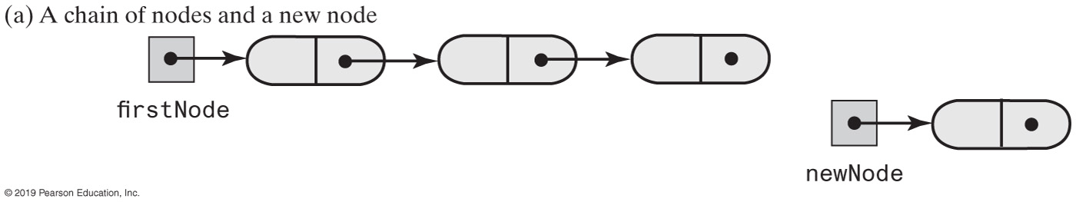
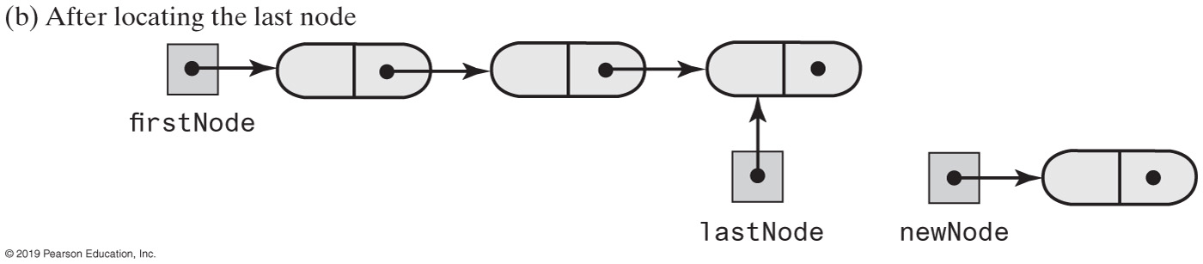
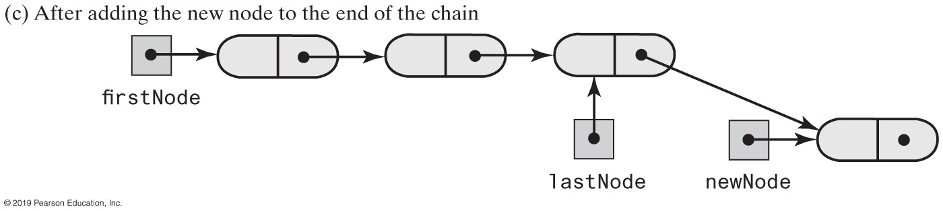
Adding a Node | End of Chain

Slide 10
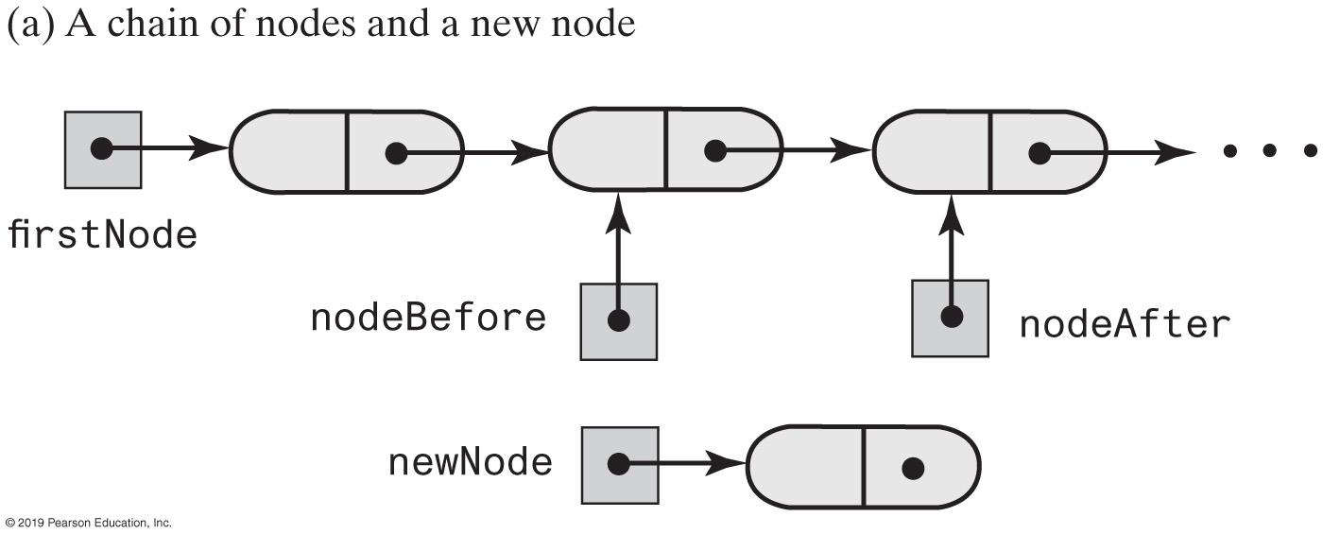
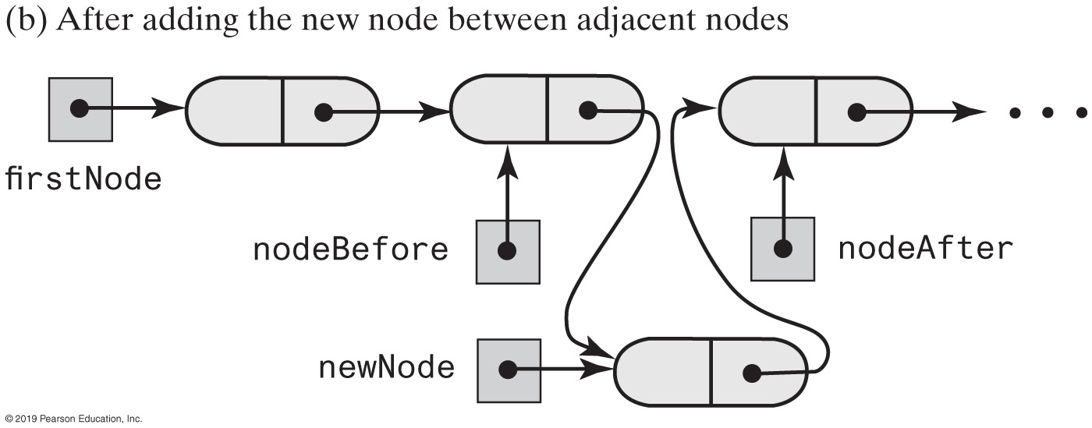
Adding a Node | Between Two Nodes

Slide 11
Adding at a Given Position
public void add(int givenPosition, T newEntry)
{
if ((givenPosition >= 1) && (givenPosition <= numberOfEntries + 1))
{
Node newNode = new Node(newEntry);
if (givenPosition == 1) // Case 1
{
newNode.setNextNode(firstNode);
firstNode = newNode;
}
else // Case 2: list is not empty
{ // and givenPosition > 1
Node nodeBefore = getNodeAt(givenPosition - 1);
Node nodeAfter = nodeBefore.getNextNode();
newNode.setNextNode(nodeAfter);
nodeBefore.setNextNode(newNode);
} // end if
numberOfEntries++;
}
else
throw new IndexOutOfBoundsException(
"Illegal position given to add operation.");
} // end add

Slide 12
Removing a Node
Possible cases
Removing the first node
Removing a node other than first one

Slide 13
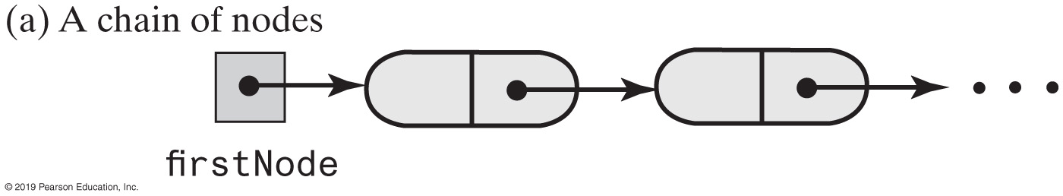
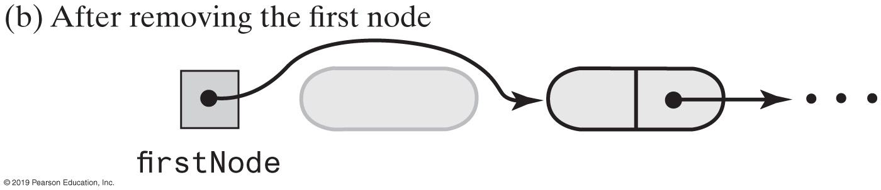
Removing the First Node

Slide 14
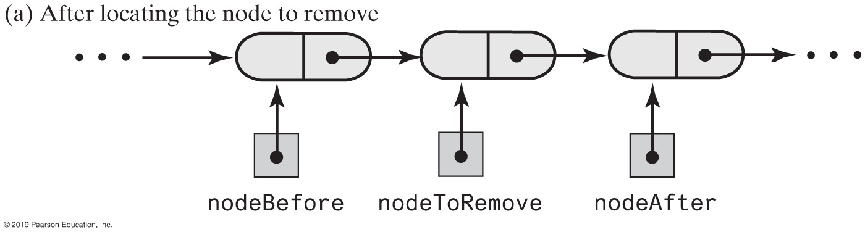
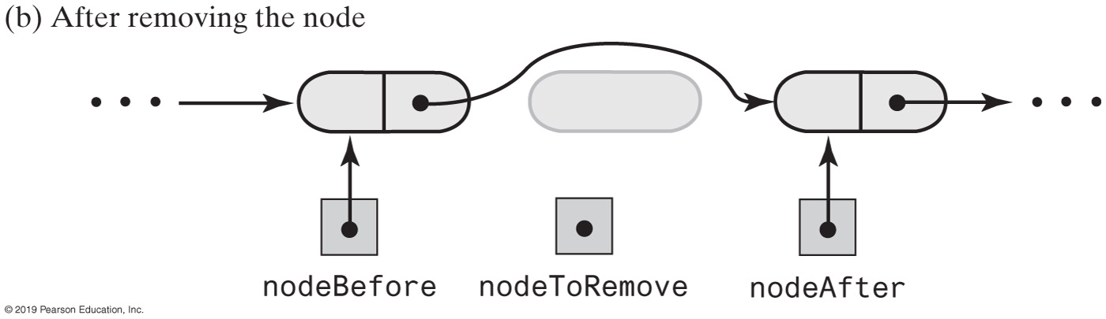
Removing an Interior Node

Slide 15
Removing a Node
// Returns a reference to the node at a given position.
// Precondition: The chain is not empty;
// 1 <= givenPosition <= numberOfEntries.
private Node getNodeAt(int givenPosition)
{
// Assertion: (firstNode != null) &&
// (1 <= givenPosition) && (givenPosition <= numberOfEntries)
Node currentNode = firstNode;
// Traverse the chain to locate the desired node
// (skipped if givenPosition is 1)
for (int counter = 1; counter < givenPosition; counter++)
currentNode = currentNode.getNextNode();
// Assertion: currentNode != null
return currentNode;
} // end getNodeAt
Operations on a chain depended on the method getNodeAt

Slide 16
remove method returns entry it deletes from list
public T remove(int givenPosition)
{
T result = null; // Return value
if ((givenPosition >= 1) && (givenPosition <= numberOfEntries))
{
// Assertion: !isEmpty()
if (givenPosition == 1) // Case 1: Remove first entry
{
result = firstNode.getData(); // Save entry to be removed
firstNode = firstNode.getNextNode(); // Remove entry
}
else // Case 2: Not first entry
{
Node nodeBefore = getNodeAt(givenPosition - 1);
Node nodeToRemove = nodeBefore.getNextNode();
result = nodeToRemove.getData(); // Save entry to be removed
Node nodeAfter = nodeToRemove.getNextNode();
nodeBefore.setNextNode(nodeAfter); // Remove entry
} // end if
numberOfEntries--; // Update count
return result; // Return removed entry
}
else
throw new IndexOutOfBoundsException(
"Illegal position given to remove operation.");
} // end remove

Slide 17
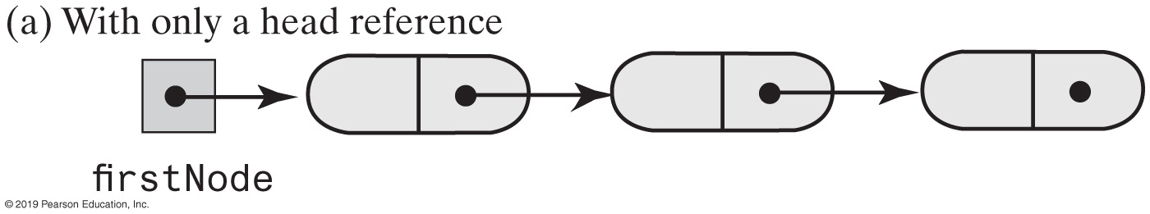
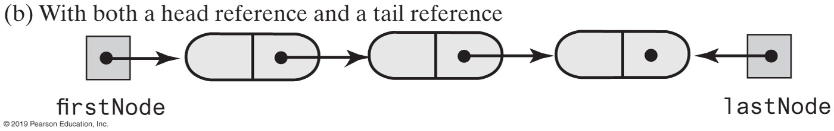
Using a Tail Reference
Two linked chains

Slide 18
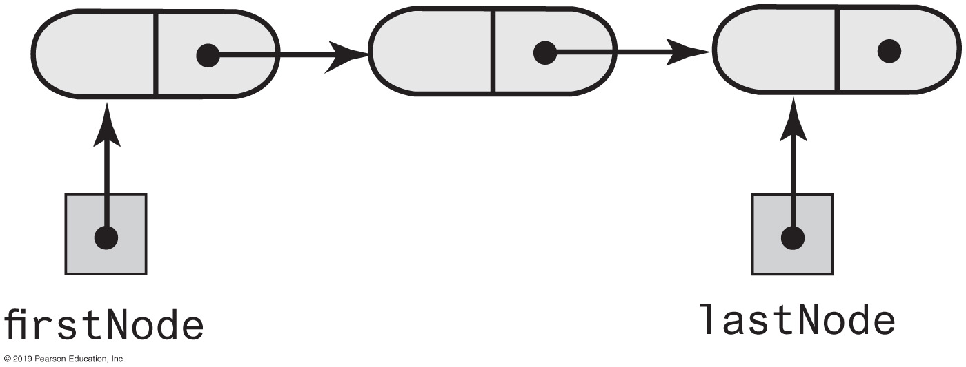
A Refined Linked Implementation
private Node firstNode; // Head reference to first node
private Node lastNode; // Tail reference to last node
private int numberOfEntries; // Number of entries in list
A linked chain with both a head reference and a tail reference

Slide 19
Method toArray
public T[] toArray()
{
// The cast is safe because the new array contains null entries
@SuppressWarnings("unchecked")
T[] result = (T[])new Object[numberOfEntries];
int index = 0;
Node currentNode = firstNode;
while ((index < numberOfEntries) && (currentNode != null))
{
result[index] = currentNode.getData();
currentNode = currentNode.getNextNode();
index++;
} // end while
return result;
} // end toArray
Traverses chain, loads an array

Slide 20
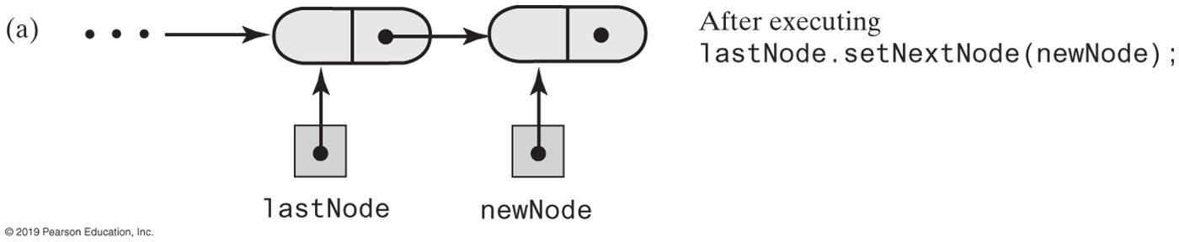
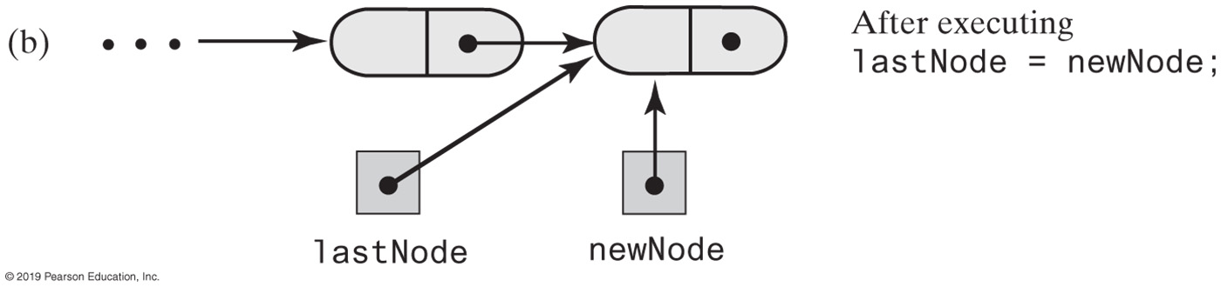
A Refined Linked Implementation
Adding a node to the end of a nonempty chain that has a tail reference

Slide 21
A Refined Linked Implementation
public void add(T newEntry)
{
Node newNode = new Node(newEntry);
if (isEmpty())
firstNode = newNode;
else
lastNode.setNextNode(newNode);
lastNode = newNode;
numberOfEntries++;
} // end add
Revision of the first add method

Slide 22
A Refined Linked Implementation - refined add by position
public void add(int givenPosition, T newEntry) {
if ((givenPosition >= 1) && (givenPosition <= numberOfEntries + 1))
{
Node newNode = new Node(newEntry);
if (isEmpty())
{
firstNode = newNode;
lastNode = newNode;
}
else if (givenPosition == 1)
{
newNode.setNextNode(firstNode);
firstNode = newNode;
}
else if (givenPosition == numberOfEntries + 1)
{
lastNode.setNextNode(newNode);
lastNode = newNode;
}
else {
Node nodeBefore = getNodeAt(givenPosition - 1);
Node nodeAfter = nodeBefore.getNextNode();
newNode.setNextNode(nodeAfter);
nodeBefore.setNextNode(newNode);
} // end if
numberOfEntries++;
}
else
throw new IndexOutOfBoundsException(
"Illegal position given to add operation.");
} // end add

Slide 23
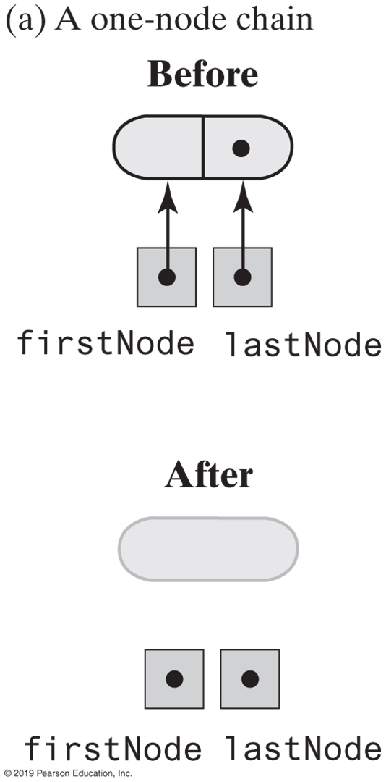
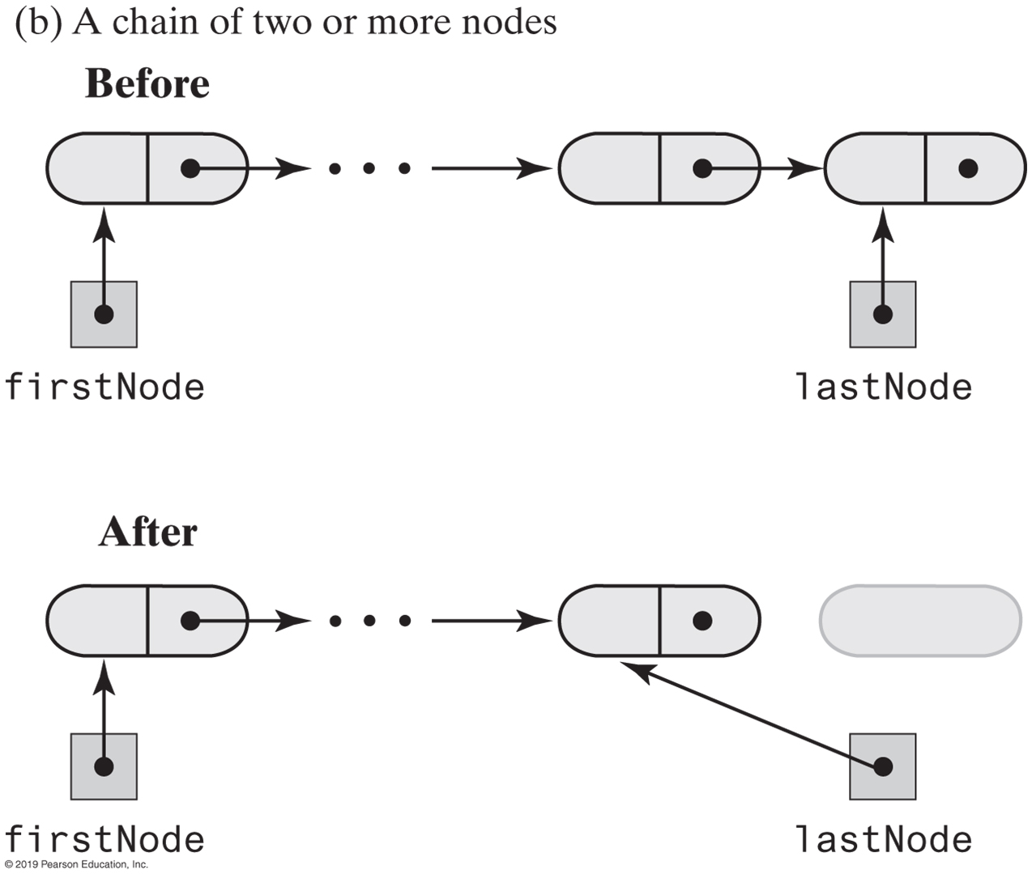
A Refined Linked Implementation
Before and after removing the last node from a chain that has both head and tail references and contains one or more nodes

Slide 24
A Refined Linked Implementation — refined remove
public T remove(int givenPosition) {
T result = null; // Return value
if ((givenPosition >= 1) && (givenPosition <= numberOfEntries))
{
// Assertion: !isEmpty()
if (givenPosition == 1) // Case 1: Remove first entry
{
result = firstNode.getData(); // Save entry to be removed
firstNode = firstNode.getNextNode();
if (numberOfEntries == 1)
lastNode = null; // Solitary entry was removed
}
else // Case 2: Not first entry
{
Node nodeBefore = getNodeAt(givenPosition - 1);
Node nodeToRemove = nodeBefore.getNextNode();
Node nodeAfter = nodeToRemove.getNextNode();
nodeBefore.setNextNode(nodeAfter);
result = nodeToRemove.getData();
if (givenPosition == numberOfEntries)
lastNode = nodeBefore; // Last node was removed
} // end if
numberOfEntries--;
}
else
throw new IndexOutOfBoundsException(
"Illegal position given to remove operation.");
return result; // Return removed entry
} // end remove

Slide 25
Implementing add at a specific position
// Precondition: The array list has room for another entry.
public void add(int newPosition, T newEntry)
{
checkIntegrity();
// Assertion: The array list has room for another entry.
if ((newPosition >= 1) && (newPosition <= numberOfEntries + 1))
{
if (newPosition <= numberOfEntries)
makeRoom(newPosition);
list[newPosition] = newEntry;
numberOfEntries++;
ensureCapacity(); // Ensure enough room for next add
}
else
throw new IndexOutOfBoundsException(
"Given position of add's new entry is out of bounds.");
} // end add

